Slide 1

ClimApp

Slide 2
Version 3.0
What’s new
iOS 13.0 ready
Translations based on user device language setting –
translations are draft versions
Notification reception ready –
only global notifications for all users at once
Can choose your location on the map
Works perfect on Android (It may be that on iOS it has trouble showing the map first time. If so, click on the gray areay, set location and try opening the map again.)
Bug fixes with respect to thermal indices
Vapour pressure
Mean radiant temperature
Forecast includes cold index
The cold index is (1 + IREQ-min – Icl_worn )
If Icl_worn > IREQ-min, then cold index is scaled between IREQ-neutral and IREQ-min
If Icl_worn > IREQ-neutral, then the heat mode should be shown
Indoor module
(Not yet functional)

Slide 3
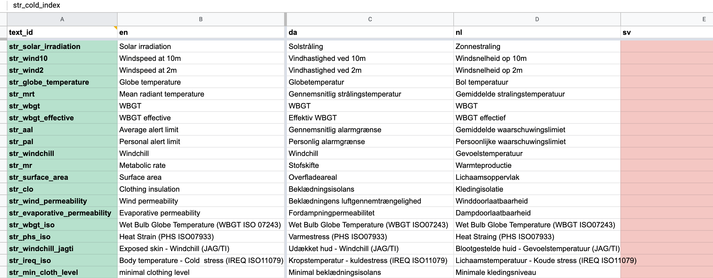
Translations
Draft translations implemented.

Slide 4
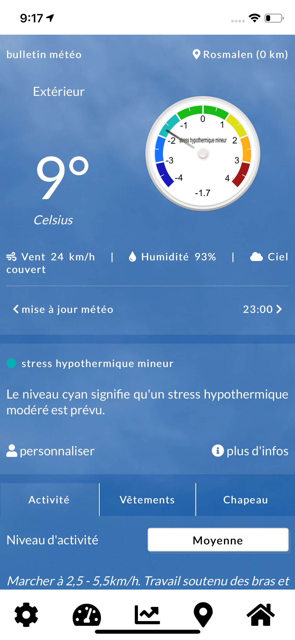
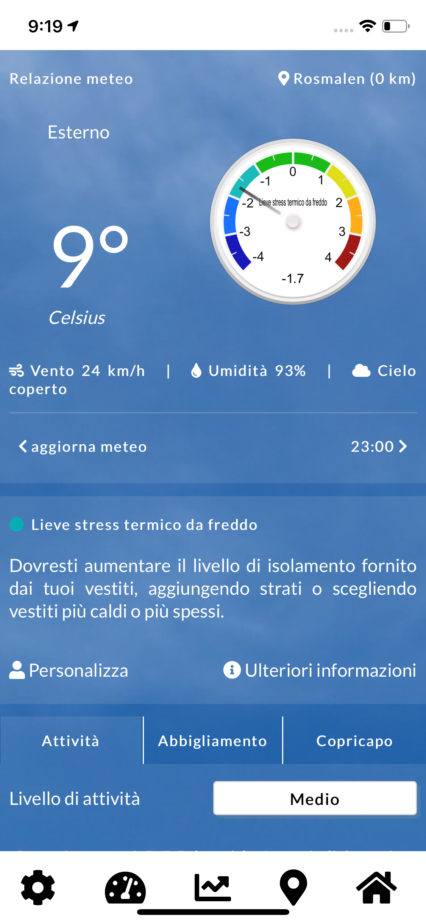



fr
it
da
de
en

Slide 5
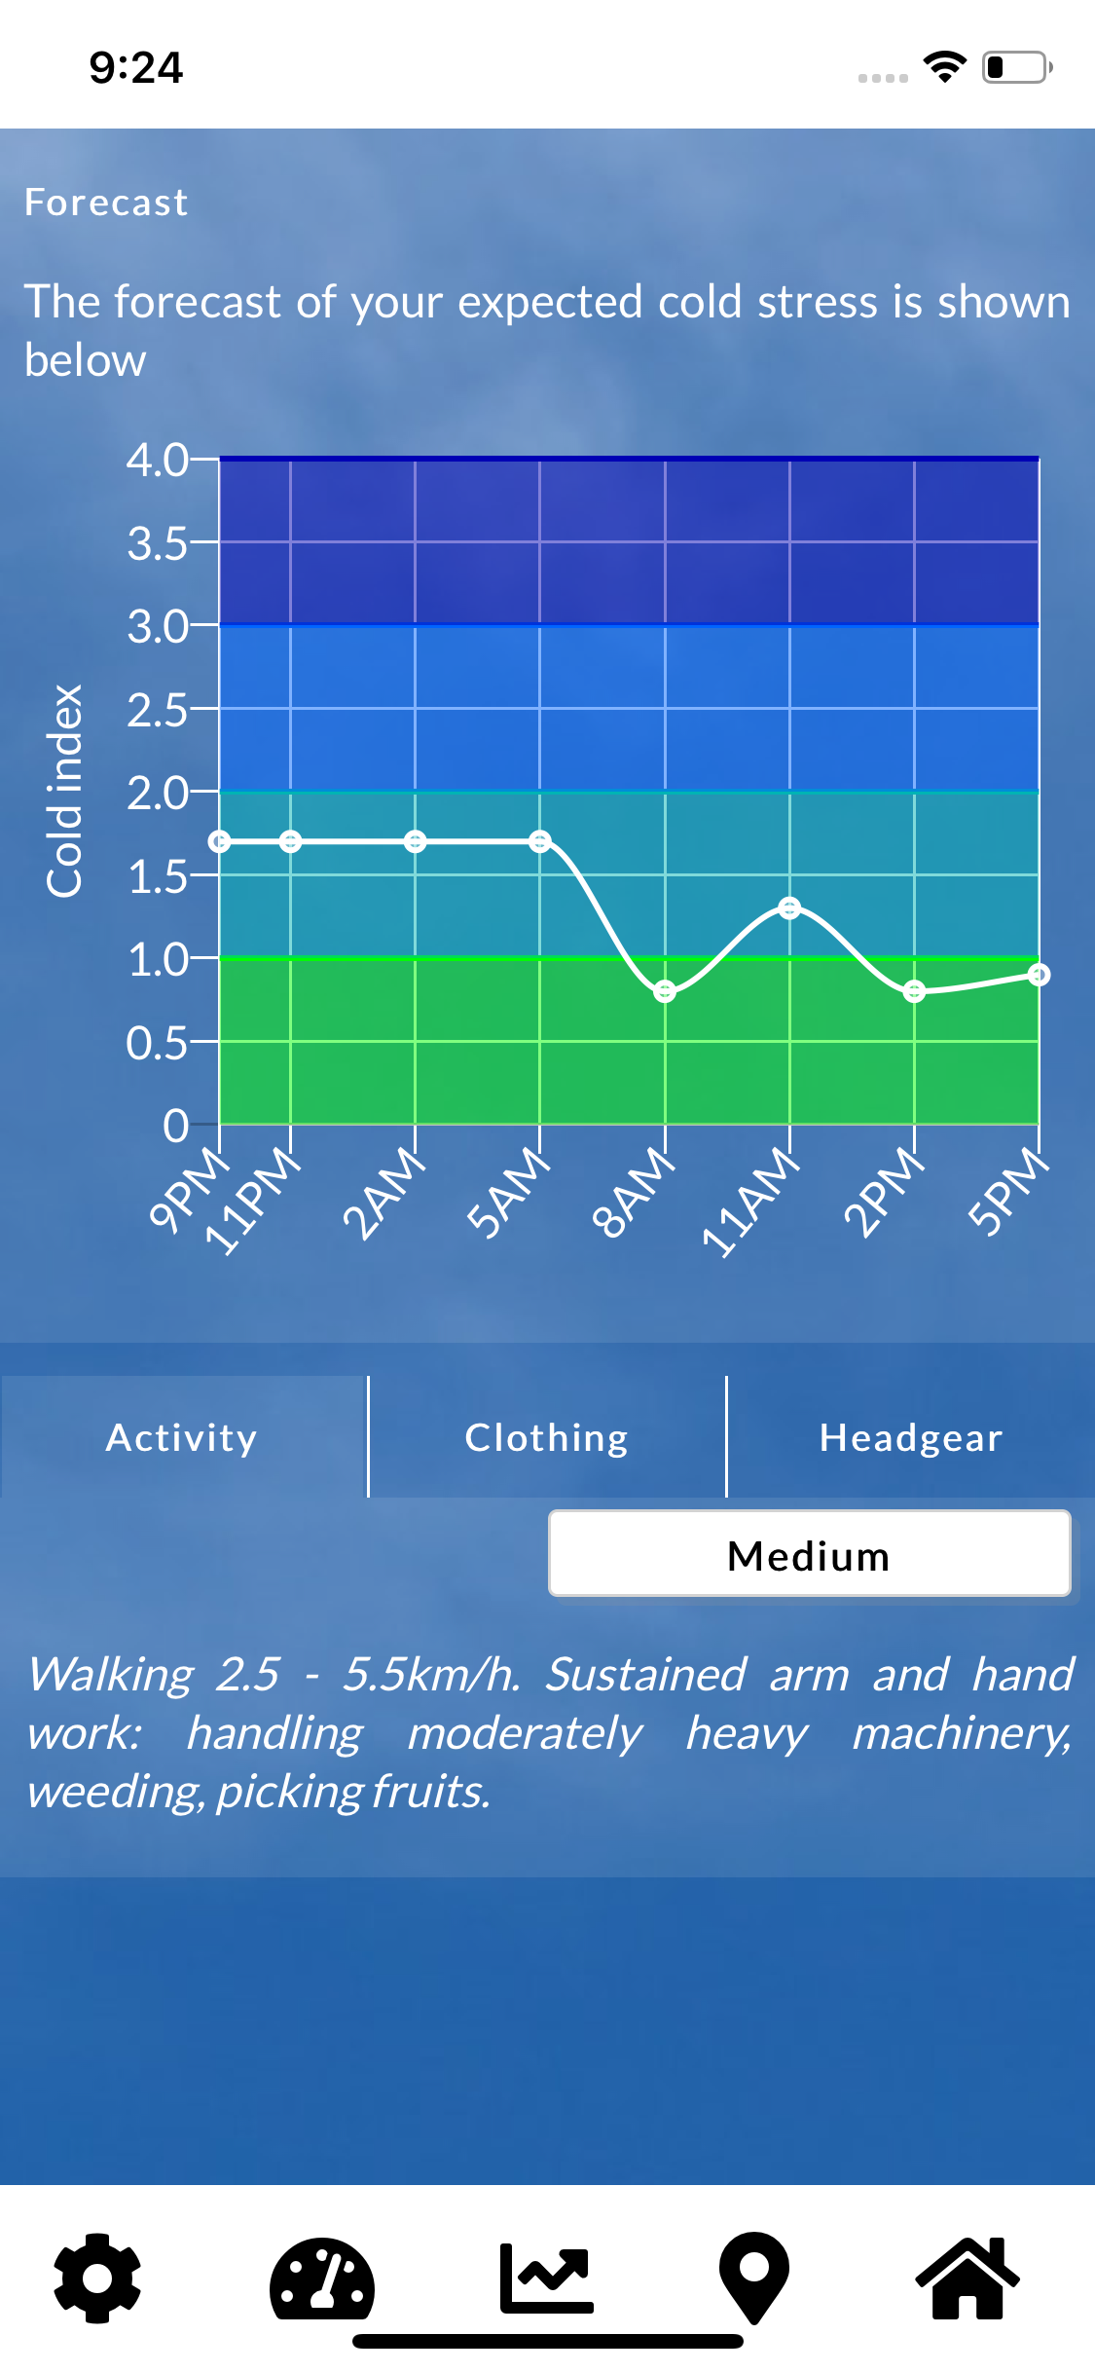
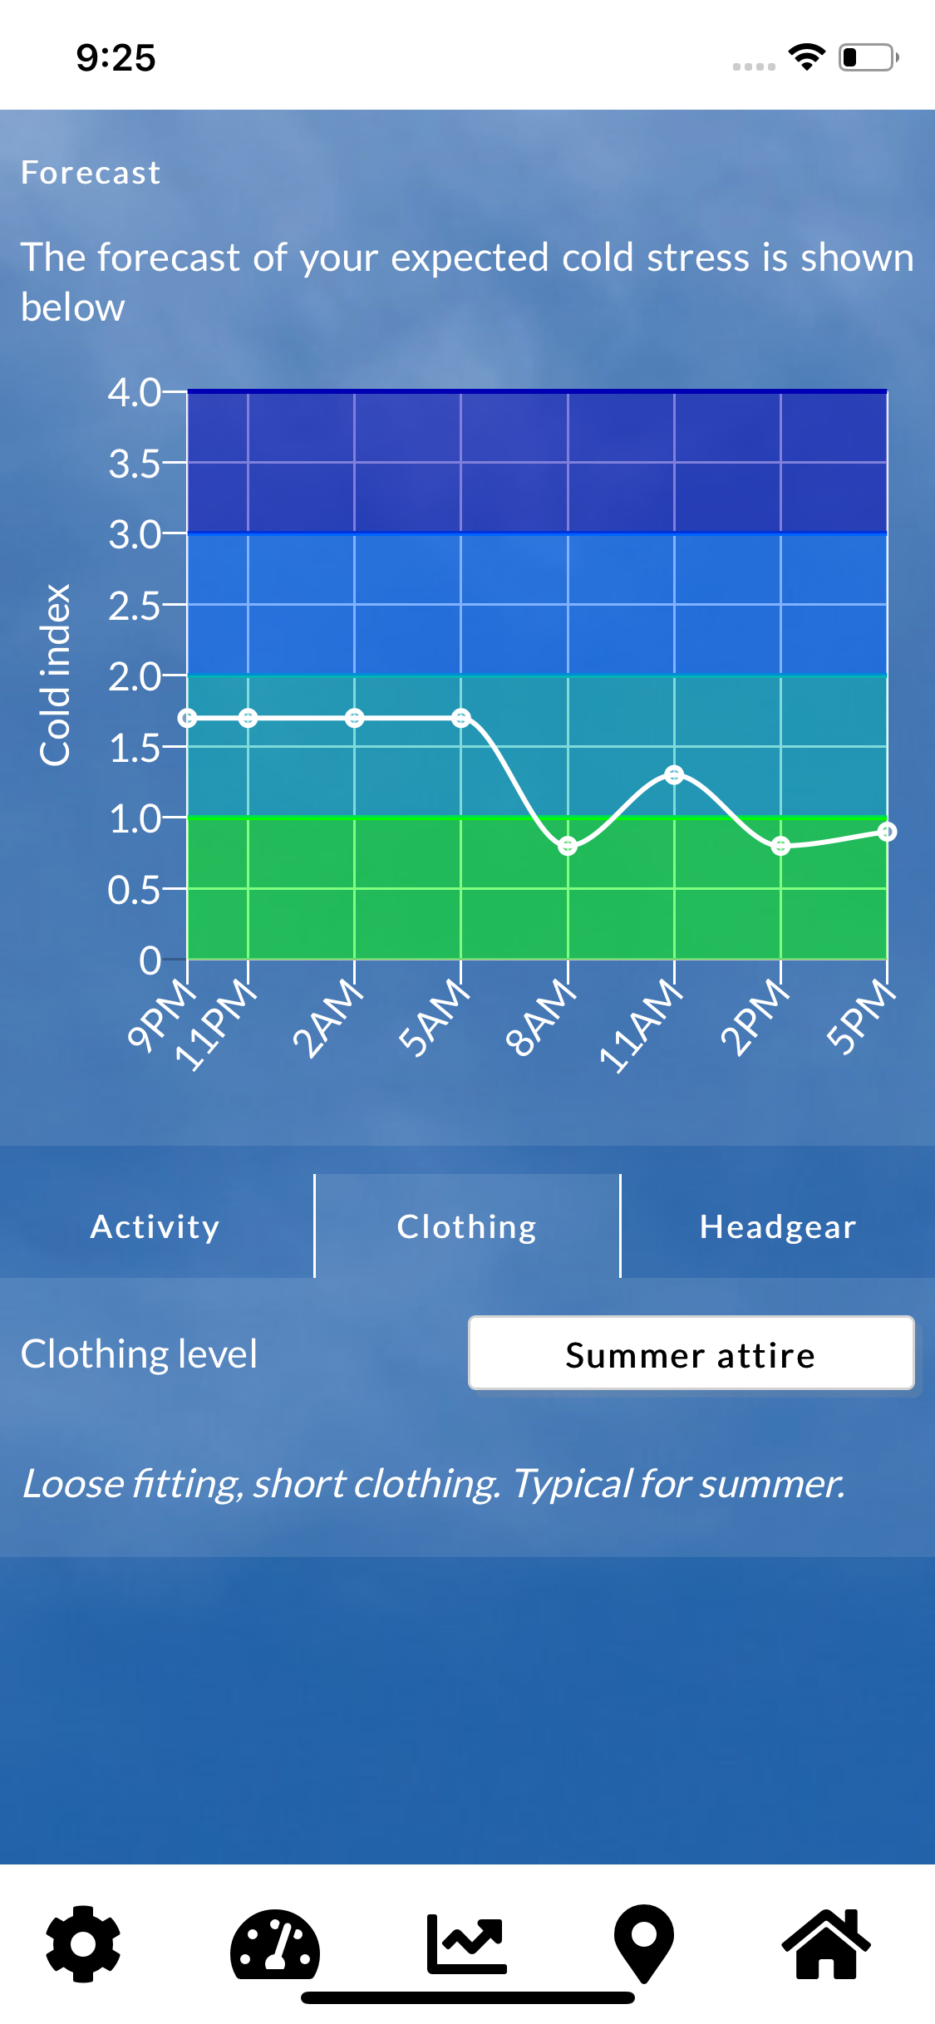
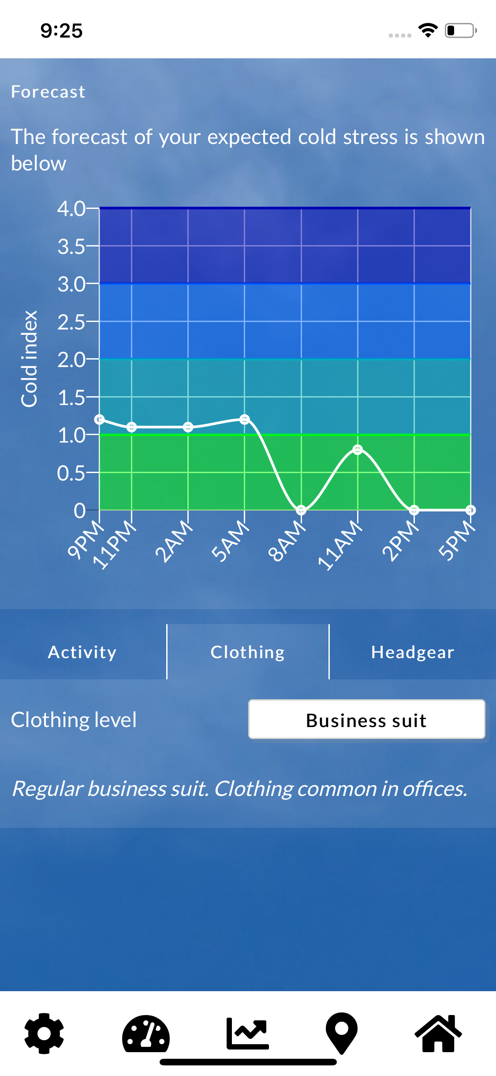

Slide 6
